Slide 1
Introduction to Using Git
Azure Training

Slide 2
Agenda
Starting with Git
Using Git Collaboratively
Branching
Best Practices
Questions?

Slide 3
Introduction to GIT – Starting with GIT
Understanding Git - Source Control
Source control refers to tracking and managing changes to code. This ensures that developers are always working on the right version of source code.
Key Features of a good source control:
Centralised code repository
Prevents unauthorized people to access and modify the code
File Versioning and auditing who made a change and when
Ability to compare versions with each other
Document changes made
Allow collaboration
Notes:
Source Control – tracking and managing changes to the code (GIT can track binary files but it is not recommended in great extent)
Version Control – similar but also for binary files

Slide 4
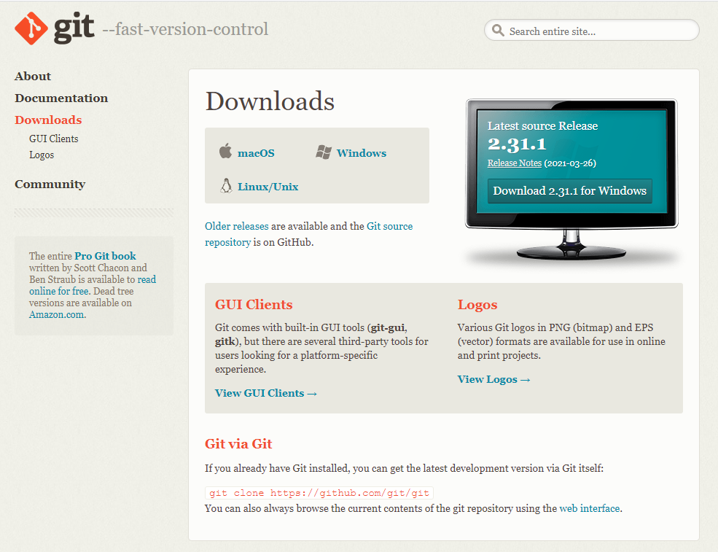
Introduction to GIT
Understanding Git - Install Git on local machine
https://git-scm.com/downloads
Notes:
https://git-scm.com/downloads

Slide 5




Introduction to GIT – Starting with GIT
Understanding Git - GIT vs TFVC
Team Foundation
Version Control (TFVC)
Centralised only - Does not have Local Repository (offline work not allowed)
Server Repo mapped to local workspaces
Have Exclusive checkout of files
Does not integrate with Azure Resources
Less Complex but Less functionality
Centralised and Distributed – Does have Local Repository
Allows offline work with repo
Does not require Server if not needed (not for enterprise solutions)
Private branches
Server Repo mapped to local Repo and Local Repo to workspace
Does not have exclusive checkouts
Integrated with Azure DevOps and Azure resources
ADF and Databricks
More Complex but more functionality
Notes:
Source Control – tracking and managing changes to the code (GIT can track binary files but it is not recommended in great extent)
Version Control – similar but also for binary files
GIT and TFVC (Can be used in dev ops)

Slide 6



Introduction to GIT – Starting with GIT
Understanding GIT – Distribution
Server/DevOps
Sync
Remote
Repo
Sync
Local Machine 1
Local Machine 2
Local Repo 1
Local Repo 2
Commits
Commits
Workspace
Workspace
Workpace 2
Developer 1
Developer 2
Notes:
Distributed means that each developer has copy version of the repository.

Slide 7

Introduction to GIT – Starting with GIT
Understanding GIT – Checkout (git checkout {branch})
Checkout:
-checkouts chosen branch into workspace
-no uncommit changes allowed on the workspace
Hot Tip:
Stash Changes if you do not want to commit changes before checkout
Local Machine 1
Local Repo 1
Checkout (branch)
Workspace
Developer 1
Notes:
Stash does not add changes to repo history but temporarily saves

Slide 8
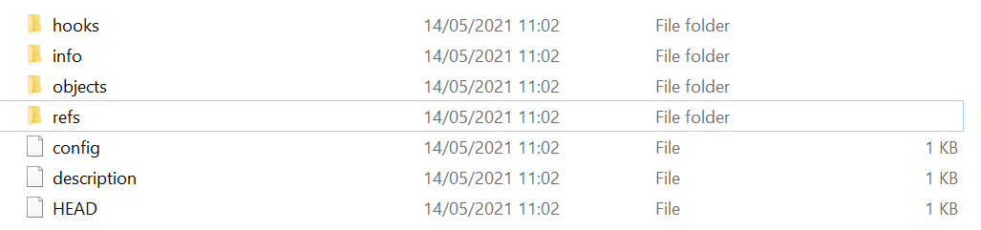
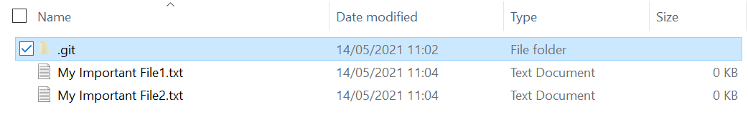

Introduction to GIT – Starting with GIT
Understanding Git - Local Repo
Repo files (auto-gen.)
Local Machine 1
Local Repo 1
Repo files (auto-gen.)
Commits
Workspace
Project Folder (with proj. files)
Developer
Notes:
Git Repo files are autogenerated and should not be directly modified!!!
Git repot contain –entire history (that was pulled already from the server) - all branches
If changes never pushed to the server and folder deleted all the changes will be lost (important to exchange with server regulary)
Workspace is file system developer is currently working on. It will store the code of the branch currently checked out. If another branch/older version of the current branch is checked out workspace code will be updated with files that represents that branch (all the changes from initial branch need to be stashed or committed in order to change code)

Slide 9
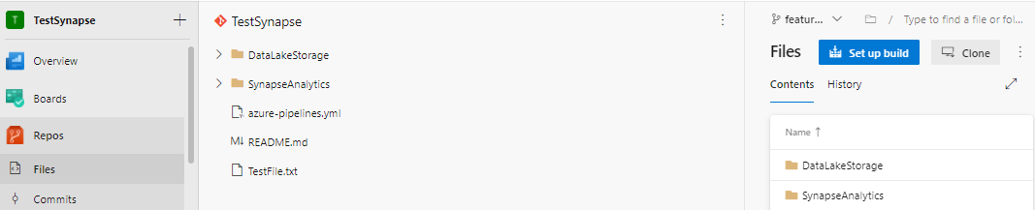
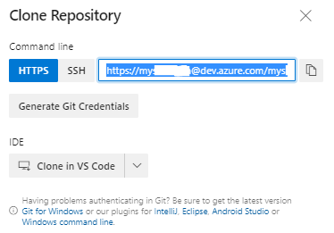
Introduction to GIT
Understanding Git – Clone Repo (git clone {url})
MS DevOps
Server/DevOps
Remote
Repo
Clone
Local Machine 1
Local
Repo 1
1
Developer 1
2
Notes:
Clone operations clone the repository (do not confuse this with forking of the repository). Cloning is obtaining the address of the serve repo and creating local copy (with maintaining the connection the server repository) When pushing changes from local to remote server version will be updated with changes.
Git need to be installed on the machine
Copy link address and then use git bash command to get the repo
Clone in visual studio use IDE of the software to copy the repository (allow IDE to connect)

Slide 10
Introduction to GIT
GIT - File tracking in git (git add {file/*})
Untracked
Unmodified
Modified
Staged
CREATE FILE
ADD
MODIFY FILE
ADD
COMMIT
File is in workspace but is not tracked
Latest snapshot IS the same as file in workspace
Latest snapshot IS NOT the same as file in workspace, but new state of file is not tracked yet
Latest snapshot IS NOT the same as file in workspace, but new state of file is tracked but is not in history yet
Notes:
Grey arrows – GIT Actions
Red Arrow – modification of the file (it is not a git action but when files get modified GIT will know this)
Flow will look like
Create new file (file is in the git workspace)
Add to source control stage (file is in the git workspace but is also staged)
Commit stage file (new snapshot of file is added to history – file becomes unmodified as latest snapshot is the same as in workspace)
Modify the file (git sees that file is modified)
Add to stage (file becomes tracked)
Commit (save snapshot to history, file is removed from staged)

Slide 11
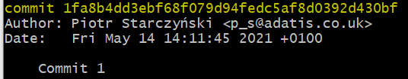
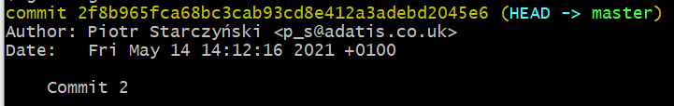

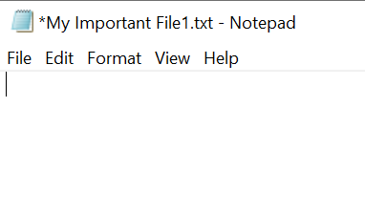
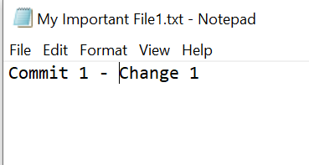
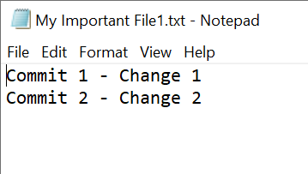
Introduction to GIT
GIT Commit (git commit –m “description”)
Saves snapshot to project history and completes the change-tracking process (move to unchanged)
Anything staged will become part of Commit Snapshot
Commit will have assigned hash number of a change (yellow) and will be visible in the history
Commit 1
Commit 2

Slide 12
Agenda
Starting with Git
Understanding Git
Tracking Changes
Basic Operations
Using Git Collaboratively
Pulling (Keeping Up-to-date)
Pushing (Keeping Up-to-date)
Fetch
Pull Requests
Branching
Best Practices
Questions?

Slide 13
Introduction to GIT – Starting with GIT
Using Git Collaboratively – Pull
Server/DevOps
Pull
Remote
Repo
GIT Pull
Obtain all ‘Public’ commits from Remote Repo
Conflicting changes will be resolved locally
Local Machine 1
Local Repo 1
Commits
Workspace
Developer 1
Notes:
Distributed means that each developer has copy version of the repository.

Slide 14
Introduction to GIT – Starting with GIT
Using Git Collaboratively –Push
Server/DevOps
Remote
Repo
Push
Local Machine 1
GIT Push
Makes your commit ‘Public’
Moves your local commit to the remote Repo
Local Repo 1
Commits
Workspace
Developer 1
Notes:
Distributed means that each developer has copy version of the repository.

Slide 15
Introduction to GIT – Starting with GIT
Using Git Collaboratively – Pull And Push flow
Server/DevOps
Pull
Remote
Repo
Push
Push
C1
C2
C3
Pull
Local Machine 1
Local Machine 2
Local Repo 1
Local Repo 2
C1
C2
C3
C1
C2
C3
Developer 1
Developer 2
Notes:
Distributed means that each developer has copy version of the repository.

Slide 16
Introduction to GIT – Starting with GIT
Using Git Collaboratively – Local & Origin Branches
Server/DevOps
Pull/Fetch
Remote
Repo
Local Machine 1
origin/main
Local Machine 2
origin/F1 Branch
Local Repo 1
origin/F2 Branch
Local Repo 2
main
main
F1 Branch
F2 Branch
Developer 1
Developer 2
Notes:
Branches are not visible when created on Server DevOps (only when pull/Fetch) as Local repo gets updated
Push/Pull -> Exchange between local and origin branches (same branches e.g., F1 and origin/F1)

Slide 17
Agenda
Starting with Git
Understanding Git
Tracking Changes
Basic Operations
Using Git Collaboratively
Pulling (Keeping Up-to-date)
Pushing (Keeping Up-to-date)
Fetch
Pull Requests
Branching
Best Practices
Questions?

Slide 18
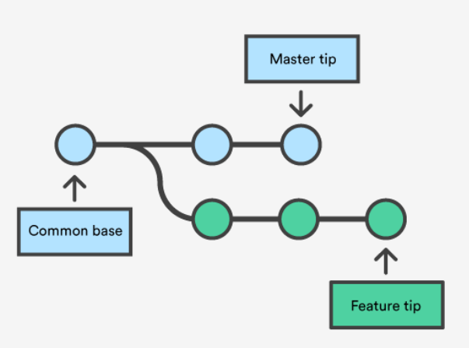
Introduction to GIT
GIT Branching
What is branching?
Branch - References that keep a history of Commits
There is mandatory one main branch that originates from root of the repository (main/master)
Can be branched of on any place of the repository tree (even from the commit in the past)
Multiple branches can root from common commit
We can switch between branches
Recommendations:
Use simple branching strategies like feature branching to isolate changes on the branch to a single requirement (Stay away from complex branching)
Keep branches short lived
Do not create to many branches
Update feature branch frequently
C1
C2
C3
C4
C5
C6

Slide 19
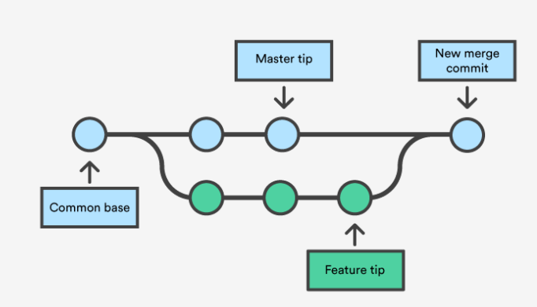
Introduction to GIT
GIT Merge
Before Merge
After Merge
Notes:
Process of moving code from source branch to target branch
Branch can be close by merging it to another branch

Slide 20
Repos – Pull Requests
What branching strategy is best?
Feature branch 1
release branch
Merge
PR1
main branch
Feature branch 2
Merge
PR2
Notes:
Shows the view of all Pull requests (Active/Completed/Abandoned)
Can be used to crate new Pull request (but usually this is done via branch tab)

Slide 21
Introduction to GIT – Starting with GIT
Using Git Collaboratively – Pull Request
Pull Request:
Way of merging the changes from your feature branches into target branch (usually main)
Generates request asking your upstream to pull changes into their tree
Summarize changes that need to be pulled into Main target branch
Can be reviewed and rejected before changes reach master
Fixes can be applied to open pull request (new commits)
Need to be completed for the code to reach the target
Recommendations(hot tips):
Merge and resolve conflict from master branch into your feature branch to make your pull request avoid hitting merging conflicts.
If something is wrong –do not abandon PR. Instead make fix on Feature branch (PR will see that change) and approve Pull Request.
Merge
Pull Request
Remote
Master (main)
Remote
Feature (Finished)
Notes:
Pull is not “Pull Request“, pull is obtain operation and pull request is a request to pull the changes that can be rejected.

Slide 22
Agenda
Starting with Git
Understanding Git
Tracking Changes
Basic Operations
Using Git Collaboratively
Pulling (Keeping Up-to-date)
Pushing (Keeping Up-to-date)
Fetch
Pull Requests
Branching
Best Practices
Questions?

Slide 23
Introduction to GIT – Best Practice
GIT – Dos and Don’ts
Tips:
When a developer picks up a new story on the sprint, they create a new branch, and include the story ID in it’s title
This means their work is completely isolated from any development currently in progress on other features
Keep the Feature branch updated from main branch, to be sure that code integrates with rest of the changes
Merge
Remote Master
Remote Feature
Local Feature
Notes:
Distributed means that each developer has copy version of the repository.

Slide 24
Introduction to GIT – Best Practice
GIT – Dos and Don’ts
Tips:
Do not make changes directly on the Remote branch
Do make changes on the Local branch only
Change Commit
Remote Branch
Change Commit
Local
Branch
Notes:
Distributed means that each developer has copy version of the repository.

Slide 25
Introduction to GIT – Best Practice
GIT – Dos and Don’ts
Tips:
Push your feature changes to Remote feature regularly to minimize risk of code loss
Unfinished Features can go to Remote Feature
Minimize amount of people working on the same feature (ideally 1 developer)
Remote Feature
Sync
Local Feature (unfinished and finished)
Notes:
Sync unfinished changes with Remote branch
Sync – Git commands executed in order: 1. git pull
2. git push

Slide 26
Introduction to GIT – Best Practice
GIT – Dos and Don’ts
Tips:
Never work directly on the master branch – use feature branch with the pull request
Pull Request
Remote master (main)
Remote Feature (finished)
Sync
Change Commit
Local master (main)
Notes:
Distributed means that each developer has copy version of the repository.

Slide 27
Introduction to GIT – Best Practice
GIT – Dos and Don’ts
Merge?
Pull Request
Remote
Master (main)
Remote
Feature
Remote
Master (main)
Remote
Feature (Finished)
Tips:
Never merge Feature Branch into Main branch use Pull request instead
Pull Request only finished feature branches
Notes:
LEFT:
Do not Merge from Remote Feature to Remote Master (Main)
RIGHT:
use Pull Request from Remote Feature to Remote Master instead – gives you more control

Slide 28
Introduction to GIT – Best Practice
GIT – Dos and Don’ts
Tips:
Never Merge or Pull Request unfinished feature branch as it will pollute the main branch with untested and possible build breaking code
Pull Request
Remote
Master (main)
Remote
Feature (Unfinished)
Notes:
LEFT:
Do not Merge from Remote Feature to Remote Master (Main)
RIGHT:
use Pull Request from Remote Feature to Remote Master instead – gives you more control

Slide 29
Introduction to GIT – Best Practice
GIT – Dos and Don’ts
Branch should be short lived – do not close before feature is finished
Maintain throughout Project and Sprints (do not leave it open when feature is closed)
Protect main/release branches with Branch Policies

Slide 30
Agenda
Starting with Git
Understanding Git
Tracking Changes
Branching
Merging
Using Git Collaboratively
Pulling (Keeping Up-to-date)
Pushing (Keeping Up-to-date)
Fetch
Pull Requests
Best Practices
Questions?

Slide 31
Questions?

